Slide 1
170520

Slide 2
Pipelining 2: Hazards
CS 3339
Lecture 8b
Greg LaKomski
Texas State University
Spring 2018
some slides ©2001-2003 Howard Huang

Slide 3
Announcements
Next homework out on 15th due 29
Cover pipeline and cache
Projects
Most are done
Two are in process

Slide 4
Review

Slide 5
Complete pipelined datapath...so far
ID/EX
WB
EX/MEM
Control
M
WB
MEM/WB
IF/ID
EX
M
WB
PC
Read register 1
Read register 2
Write register
Read data 1
0
1
2
Addr
Instr
ALU
Zero
Result
Read data 2
ALUSrc
Address
Data memory
Write Read data data
Instruction memory
0
1
2
0
Write data
Registers
1
Instr [15 - 0]
RegDst
1
Rt Rd Rs
Extend
0
0
1
EX/MEM.RegisterRd
Forwarding Unit
MEM/WB.RegisterRd

Slide 6
Data hazard review
A data hazard arises if one instruction needs data that isn’t ready yet.
Below, the AND and OR both need to read register R2.
But R2 isn’t updated by SUB until the fifth clock cycle.
Dependency arrows that point backwards indicate hazards.
Clock cycle 3 4
1
2
5
6
7
SUB | R2, R1, R3
AND | R12, R2, R5
ORR | R13, R6, R2
IM
Reg
DM
Reg
IM
Reg
DM
Reg
IM
Reg
DM
Reg
6

Slide 7
Forwarding to the rescue!
The desired value (R1 - R3) has actually already been computed—it just hasn’t been written to the registers yet.
Forwarding allows other instructions to read ALU results directly from the pipeline registers, without going through the register file.
Clock cycle 3 4
1
2
5
6
7
SUB | R2, R1, R3
AND | R12, R2, R5
ORR | R13, R6, R2
IM
Reg
DM
Reg
IM
Reg
DM
Reg
IM
Reg
DM
Reg
7

Slide 8
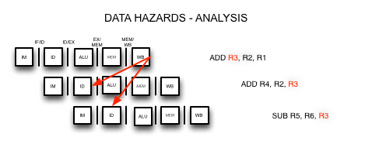
Example of Arithmetic Data Hazard
GL

Slide 9
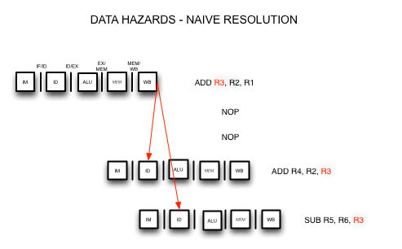
Example of Arithmetic Data Hazard
GL

Slide 10
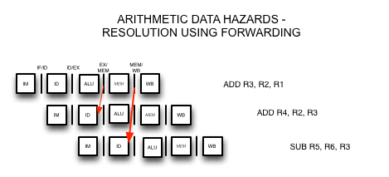
Example of Arithmetic Data Hazard
GL

Slide 11
NON ARITHMETIC HAZARDS

Slide 12

Stalls and flushes
We discussed data hazards that can occur in pipelined CPUs if some instructions depend upon others that are still executing.
Many hazards can be resolved by forwarding data from the pipeline registers, instead of waiting for the writeback stage.
The pipeline continues running at full speed, with one instruction beginning on every clock cycle.
Today we’ll see some real limitations of pipelining.
Forwarding may not work for data hazards from load instructions.
Branches affect the instruction fetch for the next clock cycle.
In both of these cases we may need to slow down, or stall, the pipeline.
April 2, 2003
©2001-2003 Howard Huang
1

Slide 13
What about loads?
Imagine if the first instruction in the example was LDUR instead of SUB.
The load data doesn’t come from memory until the end of cycle 4.
But the AND needs that value at the beginning of the same cycle!
This is a “true” data hazard—the data is not available when we need it.
Clock cycle
3 4
1
2
5
6
LDUR R2, [R3, #20]
IM
Reg
DM
Reg
AND R12, R2, R5
IM
Reg
DM
Reg
13

Slide 14

Stalling
The easiest solution is to stall the pipeline.
We could delay the AND instruction by introducing a one-cycle delay into the pipeline, sometimes called a bubble.
Clock cycle 3 4
1
2
5
6
7
LDUR R2, [R3, #20]
IM
Reg
DM
Reg
AND R12, R2, R5
IM
Reg
DM
Reg
Notice that we’re still using forwarding in cycle 5, to get data from the MEM/WB pipeline register to the ALU.
14

Slide 15

Stalling and forwarding
Without forwarding, we’d have to stall for two cycles to wait for the LDUR instruction’s writeback stage.
Clock cycle
1
2
3
4
5
6
7
8
LDUR R2, [R3,#20]
IM
Reg
DM
Reg
AND R12, R2, R5
IM
Reg
DM
Reg
In general, you can always stall to avoid hazards—but dependencies are very common in real code, and stalling often can reduce performance by a significant amount.
15

Slide 16


Stalling delays the entire pipeline
If we delay the second instruction, we’ll have to delay the third one too, and a fourth one too.
This is necessary to make forwarding work between AND and ORR.
It also prevents problems such as two instructions trying to write to the same register in the same cycle.
Clock cycle
4
1
2
3
5
6
7
8
LDUR | R2, [R3, #20]
AND | R12, R2, R5
ORR | R13, R12, R2
IM
Reg
DM
Reg
IM
Reg
DM
Reg
IM
Reg
DM
Reg
16

Slide 17
Detecting stalls
We can detect a load hazard between the current instruction in its ID stage and the previous instruction in the EX stage just like we detected data hazards.
A hazard occurs if the previous instruction was LW...
ID/EX.MemRead = 1
...and the LW destination is one of the current source registers.
ID/EX.RegisterRt = IF/ID.RegisterRs or
ID/EX.RegisterRt = IF/ID.RegisterRt
The complete test for stalling is the conjunction of these two conditions. if (ID/EX.MemRead = 1 and
( ID/EX.RegisterRt = IF/ID.RegisterRs or
ID/EX.RegisterRt = IF/ID.RegisterRt)) then stall
17

Slide 18
Implementing stalls
One way to implement a stall is to force the two instructions after LDUR to pause and remain in their ID and IF stages for one extra cycle.
Clock cycle
1 2 3 4 5 6 7 8
LDUR | R2, [R3, #20]
AND | R12, R2, R5
ORR | R13, R12, R2
IM
Reg
DM
Reg
IM
Reg
Reg
DM
Reg
IM
IM
Reg
DM
Reg
This is easily accomplished.
Don’t update the PC, so the current IF stage is repeated.
Don’t update the IF/ID register, so the ID stage is also repeated.
18

Slide 19
The missing ALU, data memory and register write
Clock cycle
4
1
2
3
5
6
7
8
LDUR | R2, [R3, #20]
AND | R12, R2, R5
ORR | R13, R12, R2
IM
Reg
DM
Reg
IM
Reg
Reg
DM
Reg
IM
IM
Reg
DM
Reg
But what about the ALU during cycle 4, the data memory in cycle 5, and the register file write in cycle 6?
Those units aren’t used in those cycles because of the stall, so we can set the EX, MEM and WB control signals to all 0s.

Slide 20
Adding hazard detection to the CPU
ID/EX.MemRead
Hazard Unit
PC Write
IF/ID Write
ID/EX
ID/EX.RegisterRt
Rs
Rt
0
0
WB
EX/MEM
1
M
WB
MEM/WB
Control
EX
M
WB
PC
IF/ID
Read register 1
Read register 2
Write register
Read data 1
0
1
2
Addr
Instr
ALU
Zero
Result
Read data 2
ALUSrc
Address
Data memory
Write Read data data
Instruction memory
0
1
2
0
Write data
Registers
1
Instr [15 - 0]
RegDst
1
Rt Rd Rs
Extend
0
0
1
EX/MEM.RegisterRd
Forwarding Unit
MEM/WB.RegisterRd

Slide 21
The hazard detection unit
The hazard detection unit’s inputs are as follows.
IF/ID.RegisterRs and IF/ID.RegisterRt, the source registers for the current instruction.
ID/EX.MemRead and ID/EX.RegisterRt, to determine if the previous instruction is LW and, if so, which register it will write to.
By inspecting these values, the detection unit generates three outputs.
Two new control signals PCWrite and IF/ID Write, which determine whether the pipeline stalls or continues.
A mux select for a new multiplexer, which forces control signals for the current EX and future MEM/WB stages to 0 in case of a stall.

Slide 22
Another way to think about stalls
The effect of a load stall is to insert an empty or nop (“no operation”) instruction into the pipeline:
LDUR R2, [R3,#20]
IM
Reg
DM
Reg
nop
IM
Reg
DM
Reg
AND R12, R2, R5
IM
Reg
DM
Reg
This is what happens explicitly in some other architectures.
The processor does not detect hazards during program execution.
Instead, hazards must be discovered during compilation, and avoided by re-arranging instructions or inserting nops.

Slide 23
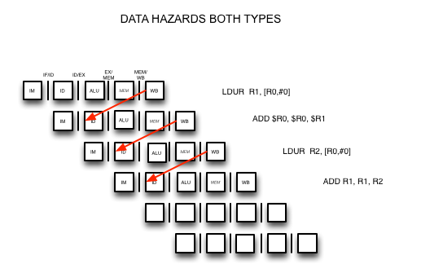
LOAD EXAMPLE

Slide 24
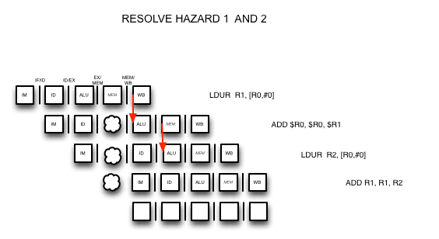
LOAD EXAMPLE
BUBBLE AND FORWARD!
FORWARD

Slide 25
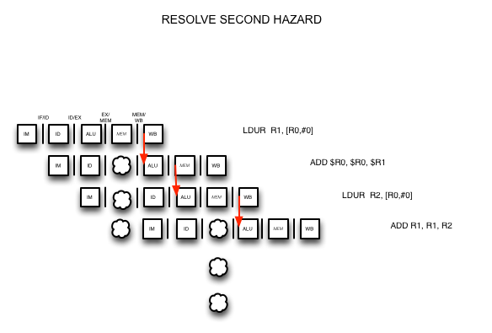
LOAD EXAMPLE
BUBBLE AND FORWARD!
FORWARD

Slide 26
Branches in the original pipelined datapath
1
0
ID/EX
WB
EX/MEM
PCSrc
Control
M
WB
MEM/WB
4
IF/ID
EX
M
WB
Add
P C
Add
RegWrite
Shift left 2
Read register 1
Read register 2
Write register
Write data
Read data 1
Read data 2
Read Instruction address [31-0]
Instruction memory
ALU
MemWrite
Zero
0
Result
Address
1
Data memory
MemToReg
Registers
ALUOp
ALUSrc
Write data
Read data
1
Instr [15 - 0]
Sign extend
RegDst
MemRead
0
Instr [20 - 16]
Instr [15 - 11]
0
1

Slide 27
Branches
Most of the work for a branch computation is done in the EX stage.
The branch target address is computed.
The source registers are compared by the ALU, and the Zero flag is set or cleared accordingly.
Thus, the branch decision cannot be made until the end of the EX stage.
But we need to know which instruction to fetch next, in order to keep the pipeline running!
This leads to what’s called a control hazard.
Clock cycle
1 2 3 4 5 6 7 8
CBNZ R3, Label
IM
Reg
DM
Reg
? ? ?
IM

Slide 28
Stalling is one solution
Again, stalling is always one possible solution.
Clock cycle
4
1
2
3
5
6
7
8
CBNZ R3, Label
IM
Reg
DM
Reg
? ? ?
IM
Reg
DM
Reg
Here we just stall until cycle 4, after we do make the branch decision.
YOU CANT EVEN LOAD THE INSTRUCTION!

Slide 29
Branch prediction
Another approach is to guess whether or not the branch is taken.
In terms of hardware, it’s easier to assume the branch is not taken.
This way we just increment the PC and continue execution, as for normal instructions.
If we’re correct, then there is no problem and the pipeline keeps going at full speed.
Clock cycle
1 2 3 4 5 6 7
CBNZ R3, Label
IM
Reg
DM
Reg
next instruction 1
IM
Reg
DM
Reg
next instruction 2
IM
Reg
DM
Reg

Slide 30






























































































Branch misprediction
If our guess is wrong, then we would have already started executing two instructions incorrectly. We’ll have to discard, or flush, those instructions and begin executing the right ones from the branch target address, Label.
Clock cycle
1 2 3 4 5 6 7 8
CBNZ R3, Label
IM
Reg
DM
Reg
ne in uction 1
xt
st
r
IM
Reg
flush
ne i u tion 2
flush
xt
ns
t
r
c
IM
Label: . . .
IM
Reg
DM
Reg

Slide 31
Performance gains and losses
Overall, branch prediction is worth it.
Mispredicting a branch means that two clock cycles are wasted.
But if our predictions are even just occasionally correct, then this is preferable to stalling and wasting two cycles for every branch.
All modern CPUs use branch prediction.
Accurate predictions are important for optimal performance.
Most CPUs predict branches dynamically—statistics are kept at run- time to determine the likelihood of a branch being taken.
The pipeline structure also has a big impact on branch prediction.
A longer pipeline may require more instructions to be flushed for a misprediction, resulting in more wasted time and lower performance.
We must also be careful that instructions do not modify registers or memory before they get flushed.

Slide 32















































Implementing branches
We can actually decide the branch a little earlier, in ID instead of EX.
Our sample instruction set has only a BEQ.
We can add a small comparison circuit to the ID stage, after the source registers are read.
Then we would only need to flush one instruction on a misprediction.
Clock cycle
1 2 3 4 5 6 7
CBNZ R3, Label
IM
Reg
DM
Reg
ne in uction 1
IM
flush
xt
st
r
Label: . . .
IM
Reg
DM
Reg

Slide 33

Implementing flushes
We must flush one instruction (in its IF stage) if the previous instruction is BEQ and its two source registers are equal.
We can flush an instruction from the IF stage by replacing it in the IF/ID pipeline register with a harmless nop instruction.
ARM uses LSL R0, R0, 0 as the nop instruction.
This happens to have a binary encoding of all 0s: 0000 0000.
Flushing introduces a bubble into the pipeline, which represents the one- cycle delay in taking the branch.
The IF.Flush control signal shown on the next page implements this idea, but no details are shown in the diagram.

Slide 34
Branching without forwarding and load stalls
1
ID/EX
0
WB
EX/MEM
IF/ID
Control
M
WB
MEM/WB
PCSrc
EX
M
WB
4
The other stuff just won’t fit on slide! ☺
P C
Add
Shift left 2
Read register 1
Read register 2
Write register
Read data 1
Addr
Instr
ALU
Zero
Result
=
ALUSrc
Read data 2
Write data
Address
Data memory
Write Read data data
Instruction memory
0
Registers
1
RegDst
1
IF.Flush
Extend
Rt Rd
0
0
1

Slide 35
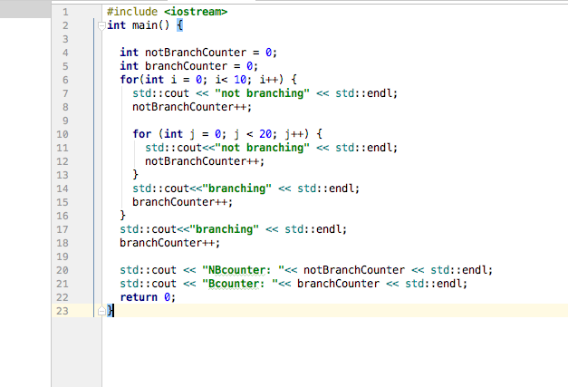
Branch prediction
A program consists of two nested loops, with a branch instruction at the end of each loop and no other branch instruction anywhere. The outer loop is executed 10 times and the inner loop 20 times. Determine the prediction accuracy percentage for the two prediction strategies: (a) always predict branch not taken, (b) always predict branch taken

Slide 36
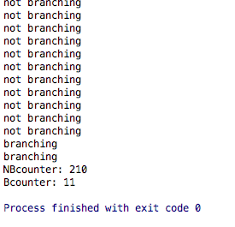
Branch prediction
A program consists of two nested loops, with a branch instruction at the end of each loop and no other branch instruction anywhere. The outer loop is executed 10 times and the inner loop 20 times. Determine the prediction accuracy percentage for the two prediction strategies: (a) always predict branch not taken, (b) always predict branch taken

Slide 37
Branch prediction
A program consists of two nested loops, with a branch instruction at the end of each loop and no other branch instruction anywhere. The outer loop is executed 10 times and the inner loop 20 times. Determine the prediction accuracy percentage for the two prediction strategies: (a) always predict branch not taken, (b) always predict branch taken
Branch Not Taken
210/221 = 95%
Branch Taken
11/221 = 5%

Slide 38
Summary
Three kinds of hazards conspire to make pipelining difficult.
Structural hazards result from not having enough hardware available to execute multiple instructions simultaneously.
These are avoided by adding more functional units (e.g., more adders or memories) or by redesigning the pipeline stages.
Data hazards can occur when instructions need to access registers that haven’t been updated yet.
Hazards from R-type instructions can be avoided with forwarding.
Loads can result in a “true” hazard, which must stall the pipeline.
Control hazards arise when the CPU cannot determine which instruction to fetch next.
We can minimize delays by doing branch tests earlier in the pipeline.
We can also take a chance and predict the branch direction, to make the most of a bad situation.

